Slide 1
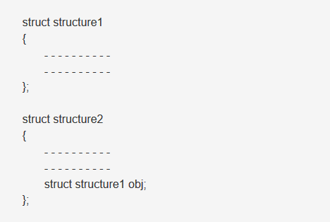
Nested Structure
When a structure contains another structure, it is called nested structure.

Slide 2
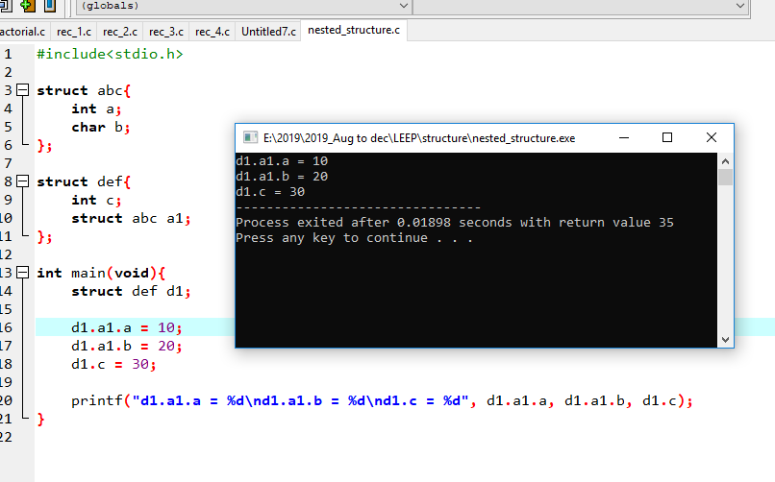
Example

Slide 3
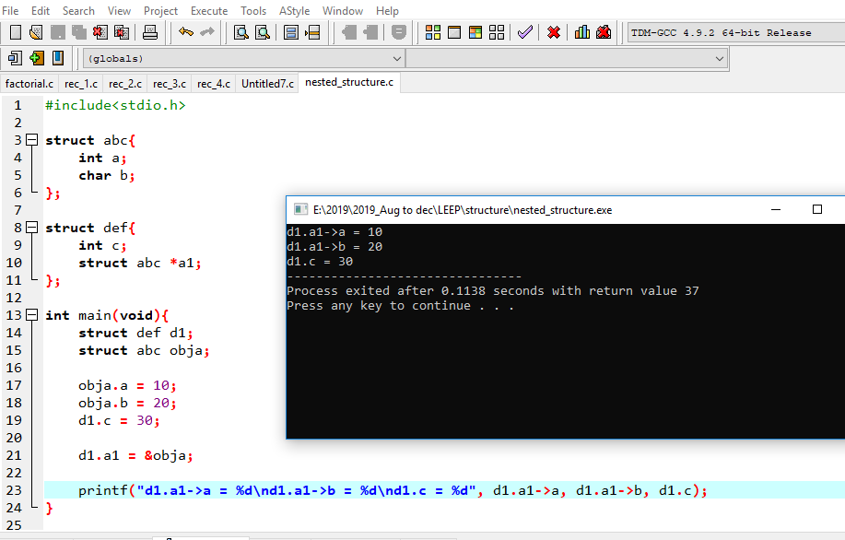
Example 2

Slide 4
Self referential Structure

Slide 5
Definition
Self Referential structures are those structures that have one or more pointers which point to the same type of structure, as their member.

Slide 6
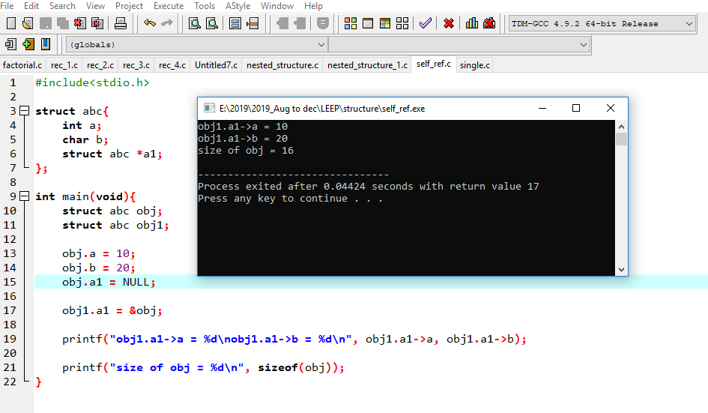
Example 1

Slide 7
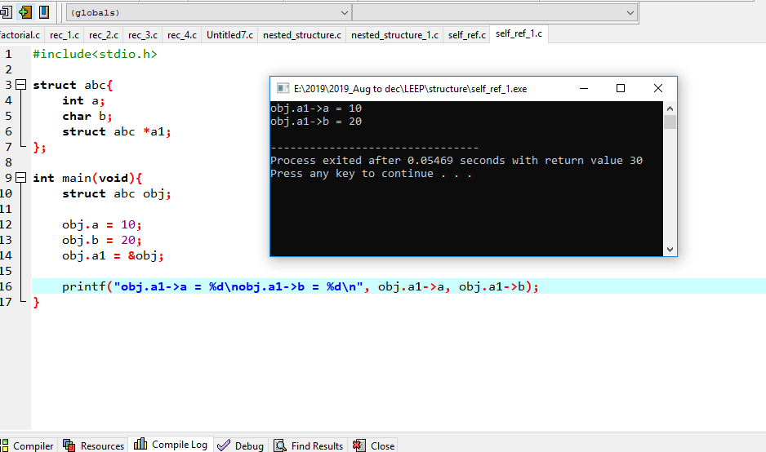
Example 2

Slide 8
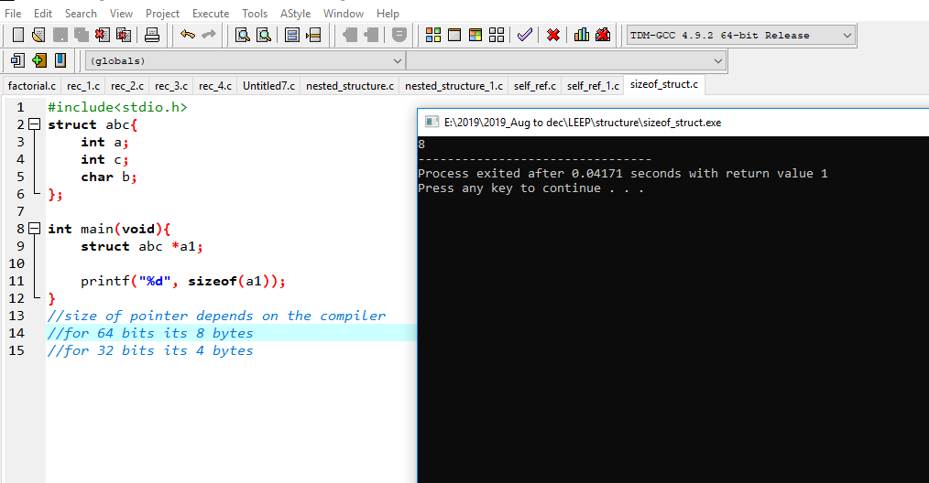
Size of pointer_compiler dependent

Slide 9

Size of pointer_compiler dependent

